Slide 1
Arrays
Week 9

Slide 2
Events
Tribeca Game Festival
https://tribecafilm.com/games
May Day

Slide 3
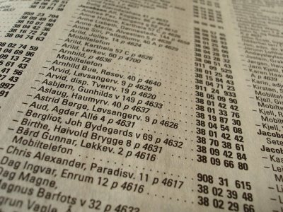
Memory is great.
Notes:
Benefit of having different storage... cabinets/containers... list... ( everyone use the one of his own preference )
We can't remember all of the information in a phone book, but the computer can. The easiest way to store all of this information is in a list.

Slide 4
An array is a list of variables.
Notes:
-Arrays are a list of variables that share a common name

Slide 5
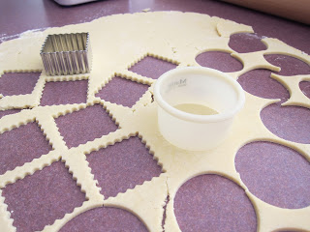
Notes:
-If you think of memory as cookie dough, what would the cooker cutter represent? a variables
- Similar to how cookie cutters are different sizes/shapes, variables can also have different values
-What would cutting out dough using a cookie cutter represent in code? declaring the variable

Slide 6
Why are arrays useful?
Notes:
-Arrays make the code: (1) shorter, (2) easier to read, and (3) more convenient to update
The following code examples are meant as quick examples to show the class (not live coding) and demonstrate how/why arrays are useful.
Code:
- file “day07_01_manyVariables” shows how NOT using an array is inefficient
- file “day07_02_arrayCircles” displays the same output as “day07_01”; difference is in the code which uses an array for x position of the circle’s center
- file “day07_02b_arrayCircles” displays the same output as “day07_02”; difference is in the code - numbers within the array "circleX" have been replaced
with variables.
-file “day07_02C_arrayCircles” shows how easy it is to make 1000 circles

Slide 7
Variable
1
Array
1
6
4
5
3
2
Notes:
Structure:
- Each item in array is an element.
- Each element has an index value to represent its position.

Slide 8
int number;
1
int[ ] number;
1
6
4
5
3
2
Notes:
How are arrays declared?
- Arrays and variables are declared in similar structures; arrays have additional square brackets.
- Live code example “day_07_03_declareAssign”

Slide 9
int[ ] number = new int[6];
number[0] = 1
number[1] = 6
number[2] = 4
number[3] = 5
number[4] = 3
number[5] = 2
1
6
4
5
3
2
Notes:
Questoins to ask class:
- What is the array name? number
- What happens if you change the number 6 to 10?
- live code “day_07_04_compactArray” (builds off previous example, so just build off your existing live code session)

Slide 10
value
1
6
4
5
3
2
[0]
[1]
[2]
[3]
[4]
[5]
position (index)
Notes:
Structure:
- Index values are structured similar to coordinates and therefore start at 0.
- We start at zero because technically the first element of the array is located at the start of
the array, a distance of zero from the beginning.
-live code “day_07_05_assignOnce” (builds off previous example, so just build off your existing live code session)
Question for class:
- what would be index value of the first element in an array? 0
- if you have an array of 1000 elements, what is the range of indices of that array?

Slide 11
Using a for loop to initialize all elements of an array
Notes:
- live code “day_07_06_forLoopArrays”

Slide 12
arrayName dot length
Notes:
- live code “day_07_06_forLoopArrays”
-Processing gives us a nice means for accessing the size of an array dynamically, using the dot syntax
-length is a property of every array and we can access it by saying “arrayName.length”

Slide 13
Why do we use arrays?
Notes:
-Ask class for examples
-Any time a program requires multiple instances of similar data, it might be time to use an array
-store scores in a video game, store colors in a data visualization, etc

Slide 14
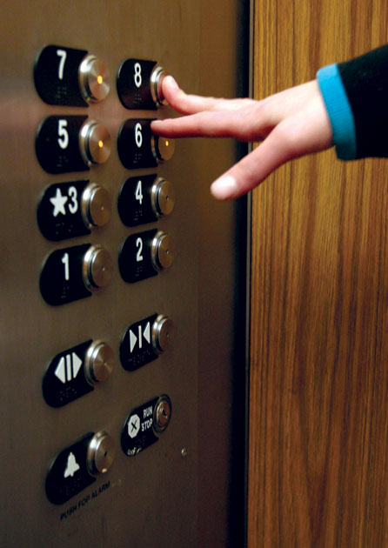
Numbers
int[ ] floors = {1,2,3,4,5,6,7}
Notes:
arrays of numbers
int a[] = {0,1,2,3,4,5,6,7,8,9};
// Elevator

Slide 15
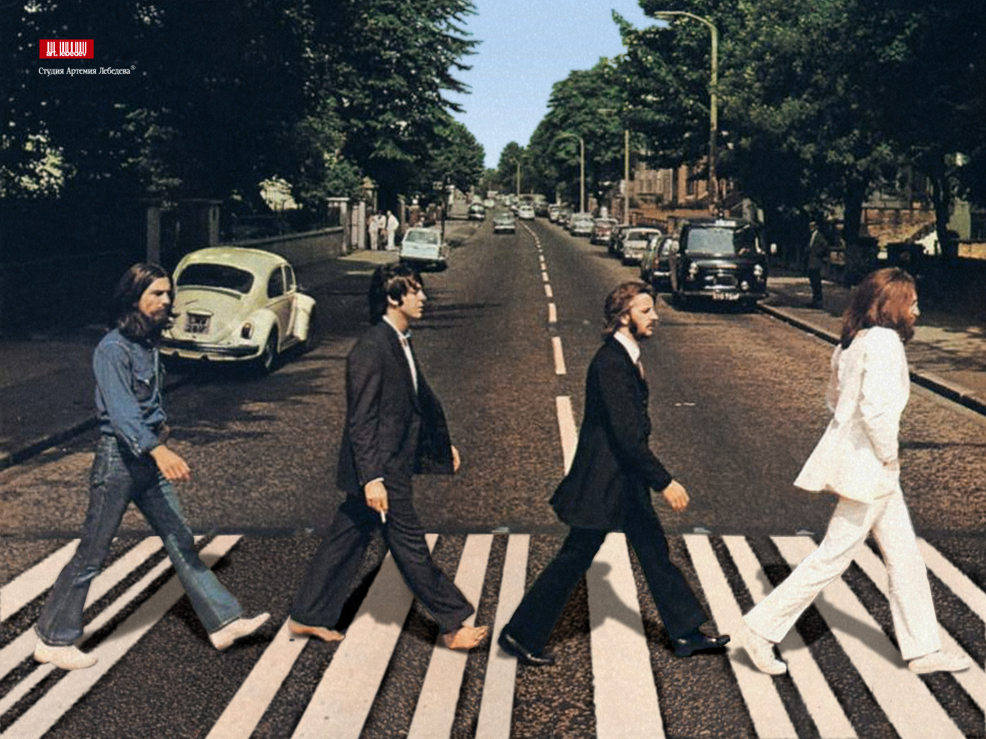
Names
String [ ] beatles = {"George", "Paul", "Ringo", "John"}
Notes:
arrays of strings
// Names

Slide 16
Strings and Numbers
String[ ] firstname = {"Alec", "Catherine", "Andy", "Rees", "Oded"}
String[ ] lastname = {"McClure", "Lewis", "London", "Shad", "Naaman"}
int[ ] phonenumber = {1929141, 1290841, 3813829, 4839184, 0382849, 2839482, 8492019}
println(firstname[0] + lastname[0] + phonenumber[0]) =
"Alec McClure 1929141"
Notes:
arrays of numbers + string
// Contact Adresses of people with ID

Slide 17
Positions (x, y)
int [ ] posX = new int[50];
for (int i=0; i<50; i++) {
posX[i] = random(width);
}
int [ ] posY = new int[50]
for (int i=0; i<50; i++) {
posY[i] = random(height);
}
// assume we have a size[] array already defined
for (int i = 0; i < 50; i++) {
ellipse(posX[i], posY[i], size[i], size[i]);
}
Notes:
arrays of positions (int x, int y)
// Drawing tools

Slide 18
Examples

Slide 19

An image is an array of colors.
Notes:
arrays of colors
// Palettes -> IMAGES

Slide 20
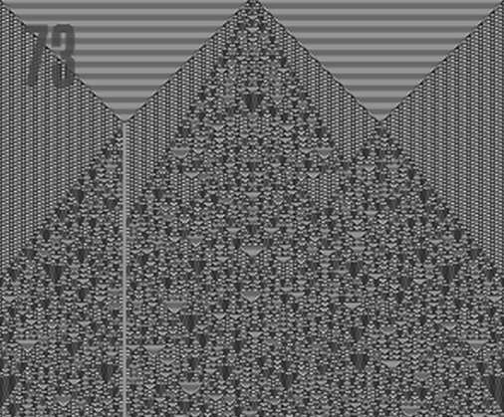
Cellular Automata

Slide 21










Animations (GIFs)
Notes:
Arrays of Images
- Animation -> video
-Sprite sheets in games. You can load an array of individual images to form animations.

Slide 22
Array Functions & Operations

Slide 23
Array Shift
spot 0 is overwritten
new value goes into spot 4
2 goes to 1
4 goes to 3
[0]
[1]
[2]
[3]
[4]
1 goes to 0
3 goes to 2
Notes:
-How would you shift all of the elements of the array down one spot?
-live code “day_07_07_shift” or show

Slide 24
sort()
//create a list of names
string names [] = { “eric”, “ken”, “raeling”};
//sort my list of names
names = sort(names);
//sort the first 2 elements of my list
names = sort(names, 2);
Notes:
-Sorts an array of numbers from smallest to largest, or puts an array of words in alphabetical order.
-The original array is not modified; a re-ordered array is returned.
-The count parameter states the number of elements to sort

Slide 25
reverse()
//create a list of names
string names [] = { “eric”, “ken”, “raeling”};
//reverse the order of my list
names = reverse(names);
Returns:
names[] = {“raeling”, “ken”, “eric”};

Slide 26
loadTable() - declaring & initializing
//declare table object
Table table;
void setup(){
//initialize a list of names
table = loadTable("codeTeachers.csv", "header");
}
Notes:
Reads the contents of a file or URL and creates an Table object with its values.
If a file is specified, it must be located in the sketch's "data" folder.
By default, the file is assumed to be comma-separated (in CSV format). To use tab-separated data, include "tsv" in the options parameter.

Slide 27
loadTable() - loading rows
void draw(){ for (int i=0; i<table.getRowCount(); i++){
int id = table.getInt(i, "id"); String firstName = table.getString(i, "firstName"); String lastName = table.getString(i, "lastName"); }

Slide 28
HOMEWORK - GE1 (10 points)
THREE SYLLABLES
TIC
TAC
TOE
(low gravity/in space)
((using for loop(s) and array(s)))
Notes:
Must use arrays and for loops

